Slide 1
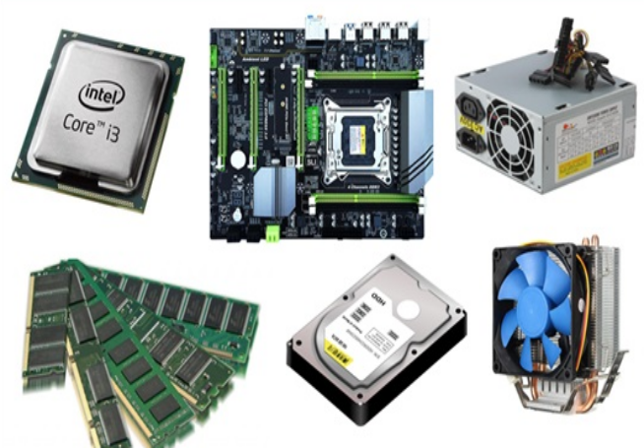
Unit 3.1 - Computer Hardware
Prepared by: Koh Kian Hua

Slide 2
Objectives (Part 2)
After completing this unit, students should be able to:
Describe the operations of the different input and output devices of a computer system.
Understand the difference between monitoring and control systems
Understand the use of sensors (including temperature, pressure, infra-red, sound) and actuators
Explain the importance of feedback in control systems.

Slide 3
Computer Hardware
Input & Output (I/O) Devices
I/O devices can consist of the following:
Printers
Speakers
Microphones
Screens
Sensors

Slide 4
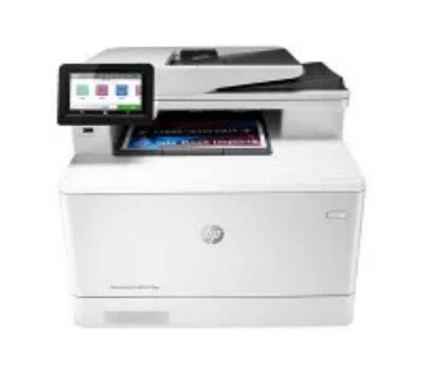
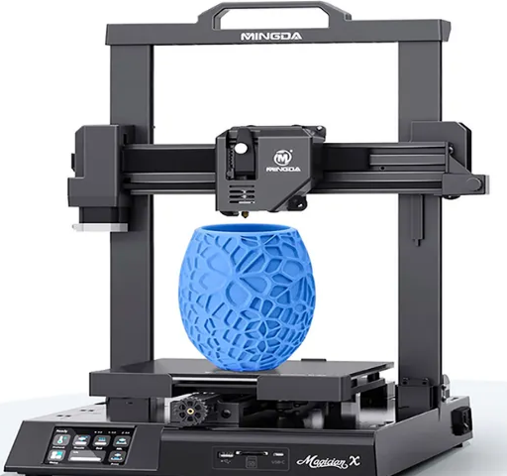
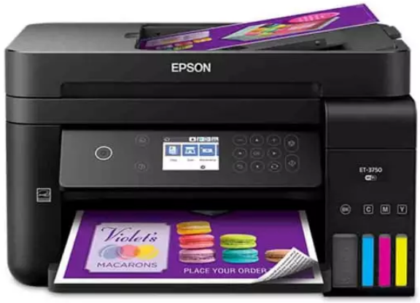
Computer Hardware
Input & Output (I/O) Devices
Printers can be classified into three main categories:
Laser Printer
Inkjet Printer
3D Printer

Slide 5
Computer Hardware
Input & Output (I/O) Devices
Description of the three main categories of printers:
Laser Printers
  Uses dry powder ink for printing
  Uses four toner cartridges: blue, cyan, magenta and black
  color dots used to build up text and images
Inkjet Printers
  Print head has nozzles spray droplets of ink into paper
  Uses a 3 color cartridge (blue, yellow and magenta) for printing
  Has stepper motor and belt that moves print head assembly and paper feed that feed the printer with pages
3D Printers
  Produces / Print working solid objects
  Uses additive manufacturing
  Solid object is build up layer by layer from materials such as powdered raisin, powdered metal, paper or ceramic

Slide 6
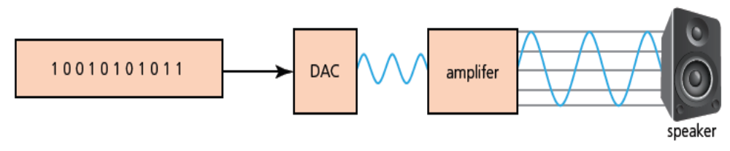
Computer Hardware
Input & Output (I/O) Devices
Speakers: an output device that connects to computer to generate sound.
Digital sound file stored in a computer is passed through a digital to analogue converter (DAC) and converted into an electric current.
This is then passed through an amplifier to create a current large enough to drive a loudspeaker.
This electric current is then fed to a loudspeaker where it is converted into sound.

Slide 7
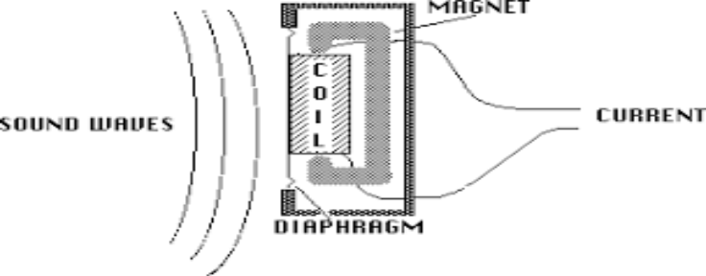
Computer Hardware
Input & Output (I/O) Devices
Microphones: an input device for converting sound waves into electrical signals which may then be amplified, transmitted, or recorded.
How microphone works:
The dynamic microphone is constructed with a small magnet that oscillates inside a coil attached to the diaphragm.
When a sound wave causes the diaphragm of the microphone to vibrate, the relative motion of the magnet and coil creates an electrical signal by magnetic induction.
The electric current is then either amplified or sent to a recording device.
The electric current is analogue in nature.

Slide 8
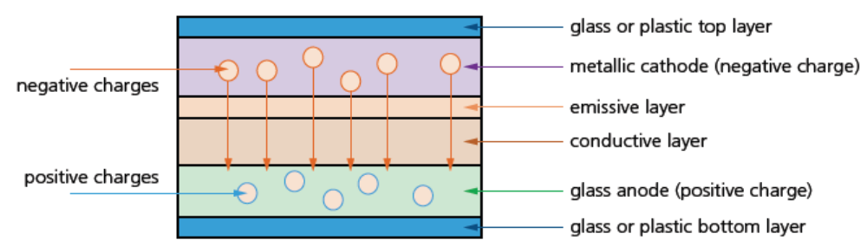
Computer Hardware
Input & Output (I/O) Devices
Screens: a device to show the output from a computer.
Modern screens use a LCD or the newer organic light emitting diode (OLED) technology
How OLEDs work:
Use organic materials to create flexible semiconductors.
Organic films are sandwiched between two charged electrodes (cathode and anode)
When an electric field is applied to the electrodes, they give off light.
Hence, no back lighting is required and OLED supports very thin screens.
No need for a LCD as OLED is a self-contained system

Slide 9
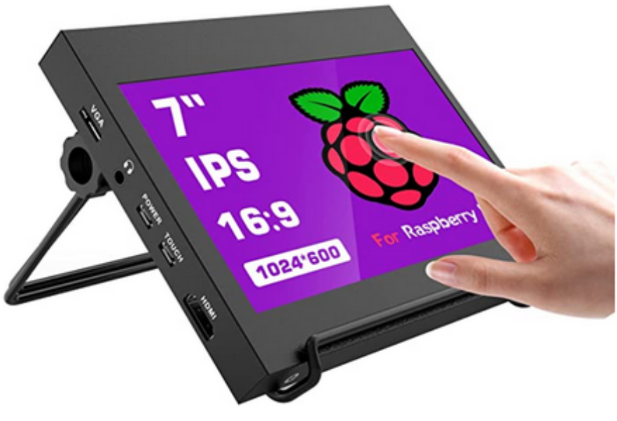
Computer Hardware
Input & Output (I/O) Devices
Touch Screens: A display device that allows users to interact with a computer using their finger or stylus (pen-shaped instrument). Touch screens are used on various devices, such as computer and laptop displays, smartphones, tablets.

Slide 10
Computer Hardware
Input & Output (I/O) Devices
Touch Screens: Can be classified into two categories
  Capacitive Touch Screen: a control display that uses the conductive touch of a human finger or a specialized device for input.
    Advantages: mediun cost, good screen visibility in strong sunlight, allows multi-touch capability and screen is very durable
    Disadvantages: Only allows use of bare fingers as the form of input; although the latest screens permit the use of a special stylus to be used.
  Resistive Touch Screen: allow both finger and non-finger input (e.g:stylus). They generally support single-finger touch and basic gestures, and cost less to produce.
    Advantages: cost less to produce, support the use of fingers and stylus to carry out input operations.
    Disadvantages: poor screen visibiloty in strong sunlight, no multi-youch capability and screen vulnerability is average (prone to scratches and screen wears out through time)

Slide 11
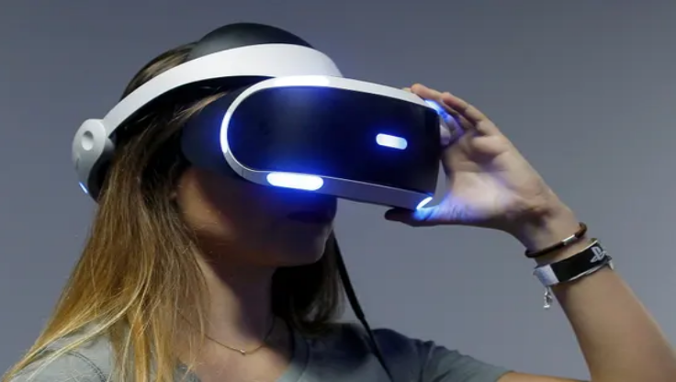
Computer Hardware
Input & Output (I/O) Devices
Virtual Reality (VR) Headsets: A head-mounted device that provides virtual reality for the wearer. Virtual reality headsets are widely used with video games but they are also used in other applications, including simulators and trainers.
Practical Application of VR headsets includes:
  Used for training purpose such as ‘walking around’ inside dangerous areas – such as a nuclear power plant – without actually being there.
  Planning modifications or repairs to a plant in a safe manner and to try out different scenarios first before implementing them.
Is VR headset an input or output device ?

Slide 12
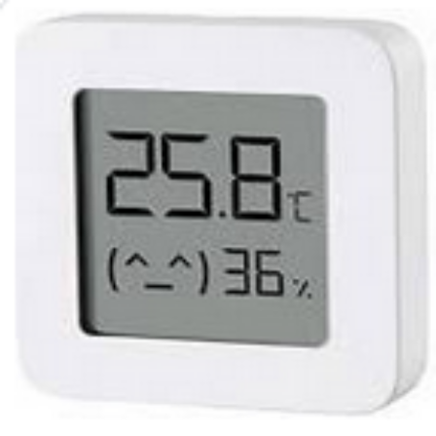
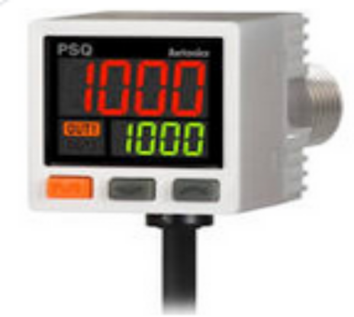
Computer Hardware
Input & Output (I/O) Devices
Sensors: Input devices which read or measure physical properties, such as temperature, pressure and humidity.
Temperature / Humidity Sensor
Pressure Sensor

Slide 13
Computer Hardware
Input & Output (I/O) Devices
Practical Use of Sensors (Water Sprinklers): Thermosensitive devices such fire water sprinkers react at predetermined temperatures by automatically releasing a stream of water over designated areas.
How Fire Water Sprinkers works
Real data such as temperature is analogue in nature (no discrete value). Computers are unable to interpret analogue values. These values have to be converted into digital format through analogue to digital converter (ADC) in order for computers to control these devices. An actuator (electromechnaical device such as valve relay or motor) is used to control these devices. The sensor readings as it reaches a certain value causes a microprocessor to alter a motor or control valve of a device (eg: water sprinker).

Slide 14
Computer Hardware
Types of Sensors and their Applications
Temperature Sensor
Measures heat generated by an object or system. By measuring the change in heat, the sensor can detect changes in temperature. Practical applications includes:
  Chemical process or reaction
  Central heating (thermostat) / air-con
  Greenhouses
  Ovens, refrigerators and freezers
Humidity Sensor
Moisture sensors measures the amount of moisture in a certain material whilst humidity sensors measure the amount of moisture in the air, along with its temperature. Practical applications includes:
  Clothes dryer
  Environmental control / greenhouse, air-con
pH Sensor
Measures how acidic or alkaline a material is. Practical applications includes:
  Water treatment plants
  Pollution monitoring (river)
  Aquariums

Slide 15
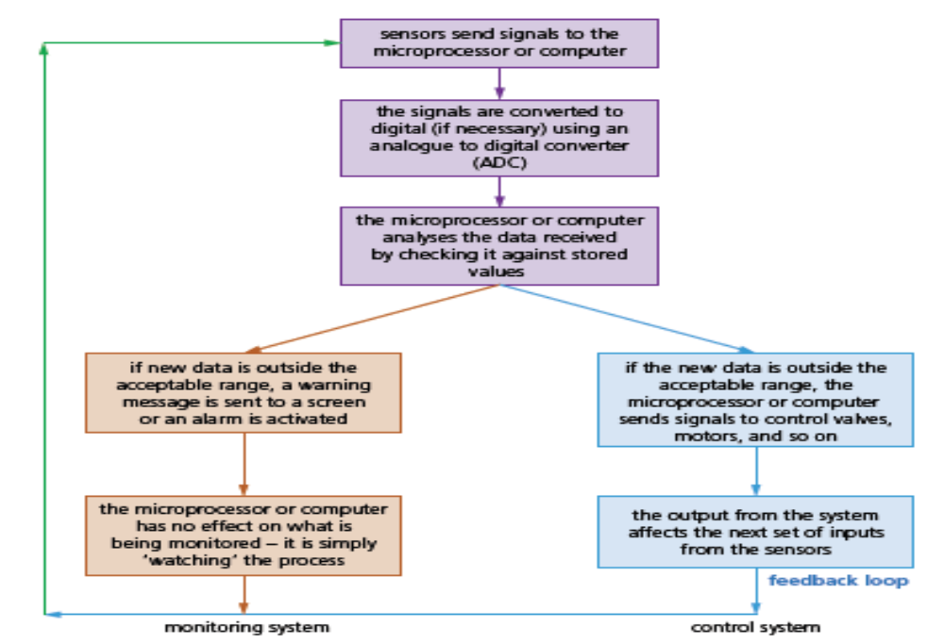
Computer Hardware
Flow-chart of how Sensors are used in monitoring and control applications

Slide 16
Computer Hardware
Uses of sensors in monitoring and control applications
Examples where sensors can be used for monitoring applications
Monitoring a patient for vital signs (eg: heart rate, temperture)
Checking whether an unauthorized person has access a protected / restricted area
Checking the temperature of car engine
Monitoring river water pollution.
Examples where sensors can be used for control applications
Turning street lights on / off during daytine and nigh time
Controlling temperature in a oven, or a central air-conditonal system
Controlling traffic light in a junction

Slide 17
Computer Hardware
Class Activity
1) Explain the main differences between an inkjet and a laserjet printer
2) Name two different sensors and describe an application for each of these sensors.

